Slide 1

Spawn - Cloud Native Actor Mesh
Elug SP - Meetup Adriano Santos, August 05th 2023

Slide 2


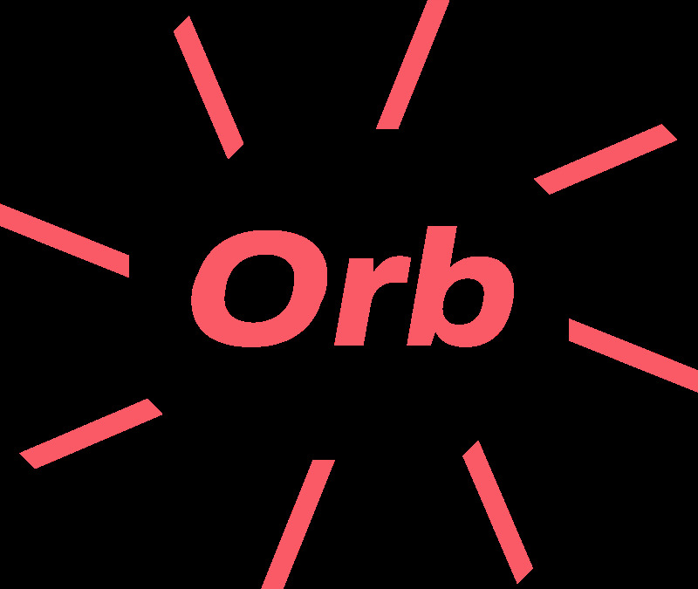










defvm beam!(otp), do:
eigr.io – Spawn Cloud Native Service Mesh
Light-Weight Process (Actors!)
No shared memory
Messaging passing
Immutable data
Soft real time
Easily distributed services
Location transparency
BEAM
Elug SP - Meetup 2023

Slide 3

eigr.io – Spawn Cloud Native Service Mesh
Thinking
Elug SP - Meetup 2023

Slide 4
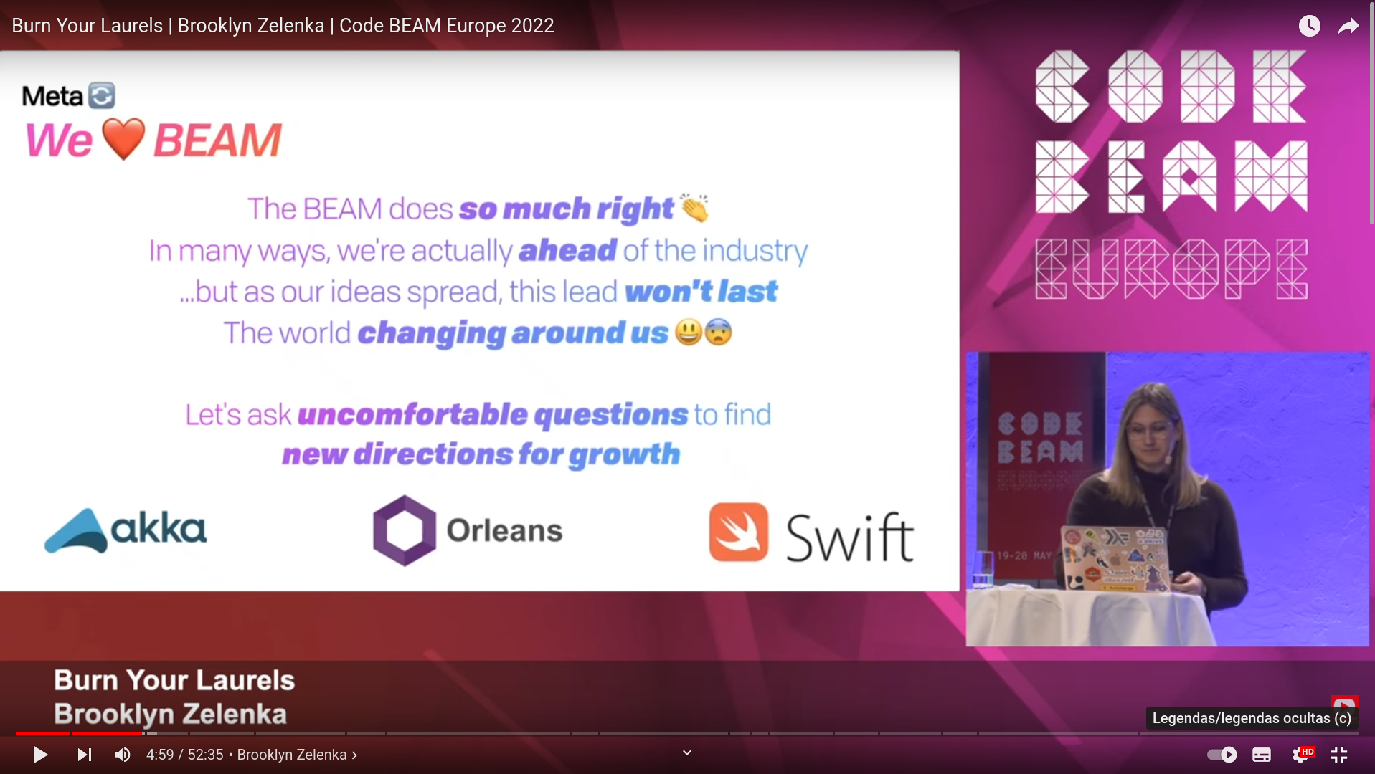
eigr.io – Spawn Cloud Native Service Mesh
Elug SP - Meetup 2023

Slide 5
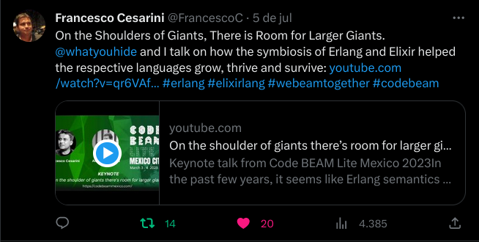
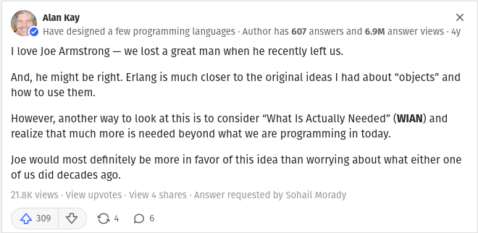
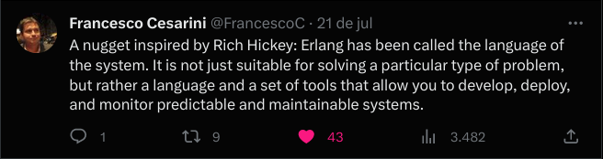
eigr.io – Spawn Cloud Native Service Mesh
Elug SP - Meetup 2023

Slide 6





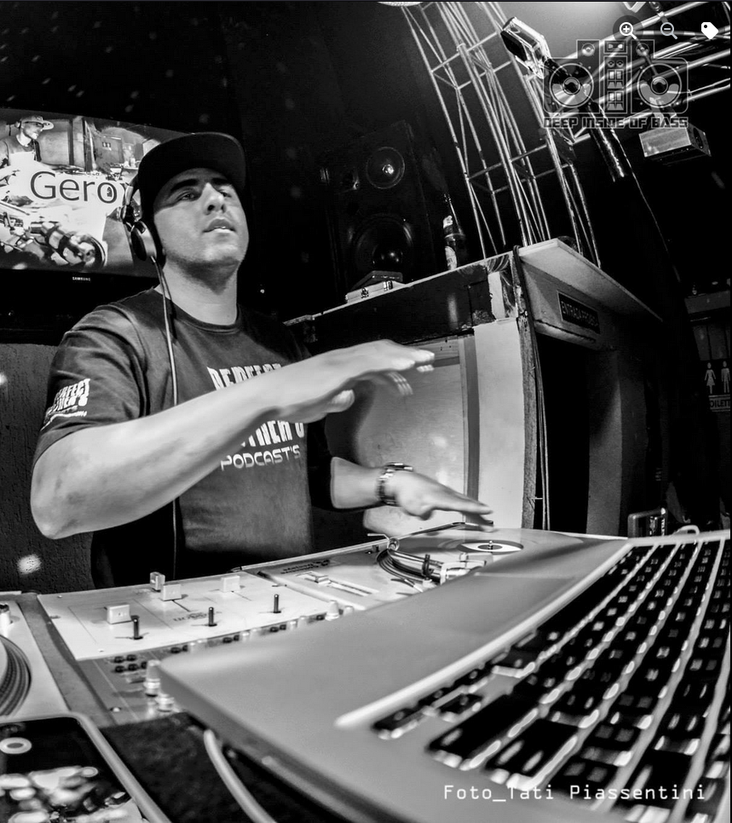
Adriano Santos
eigr.io – Spawn Cloud Native Service Mesh
@sleipni_r
@sleipnir
Playing professionally with computers for over two decades.
Enthusiastic OSS with contributions in some projects of different communities (akka streams, cloudstate, bonny, kompost, Eigr projects, and many others).
Father.
Former athlete.
Former DJ.
My interests are distributed systems, biology, astronomy, rockets…
My hobbies are cinema, series, books, animes, sports, music, and play the drum…
Elug SP - Meetup 2023

Slide 7

What is Spawn Actor Mesh?
eigr.io – Spawn Cloud Native Service Mesh
hello mom Elixir
Hello Daddy Kubernetes
Spawn is a Stateful Serverless Runtime based on the Actor Model and operates as a Service Mesh.
My name is Spawn
Elug SP - Meetup 2023

Slide 8
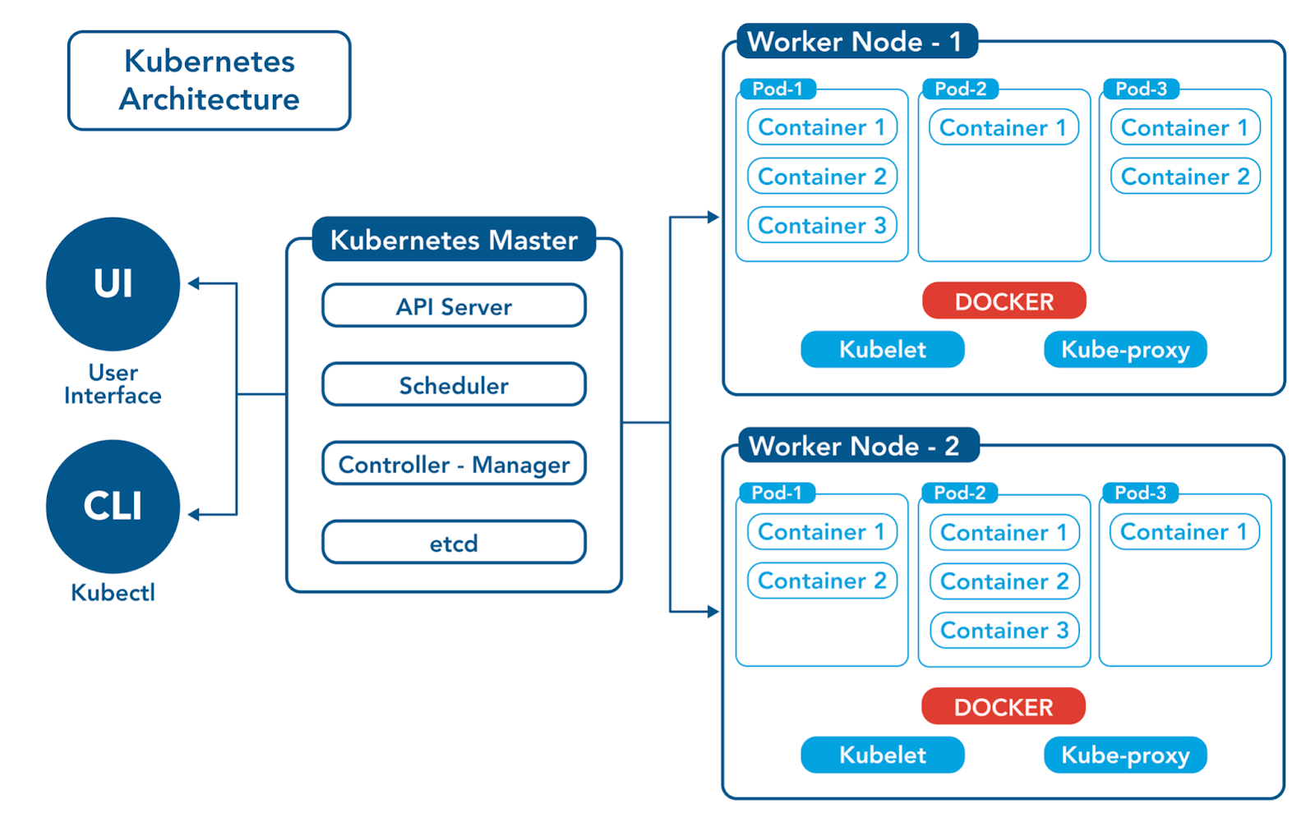
What is k8s?
eigr.io – Spawn Cloud Native Service Mesh
Kubernetes is a portable, extensible, open source platform for managing “containerized” workloads and services, that facilitates both declarative configuration and automation.
Elug SP - Meetup 2023

Slide 9
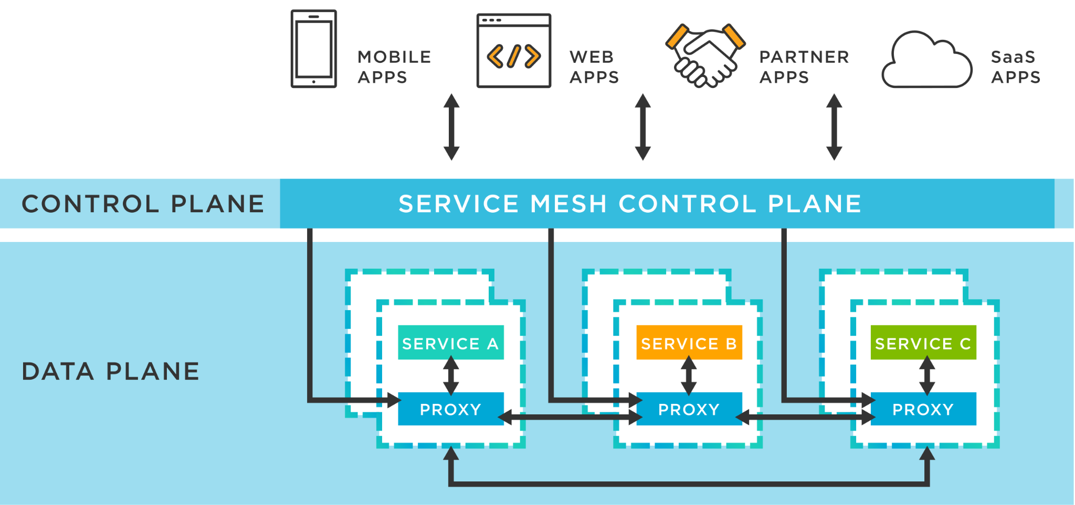
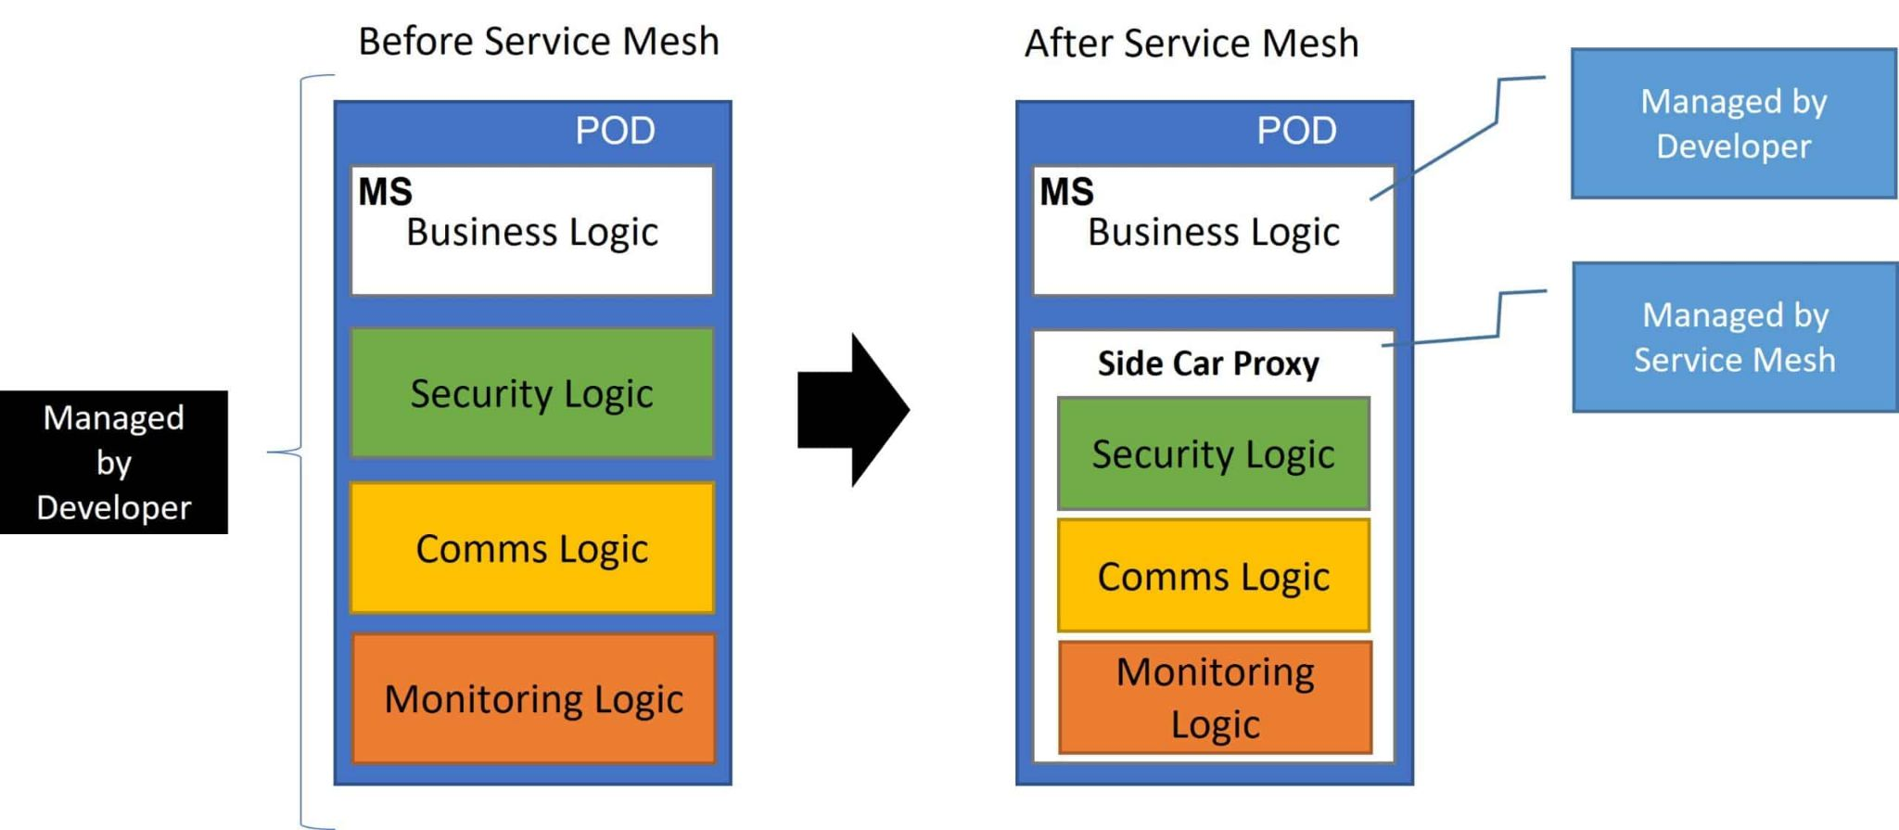
What is Service Mesh?
eigr.io – Spawn Cloud Native Service Mesh
Elug SP - Meetup 2023

Slide 10
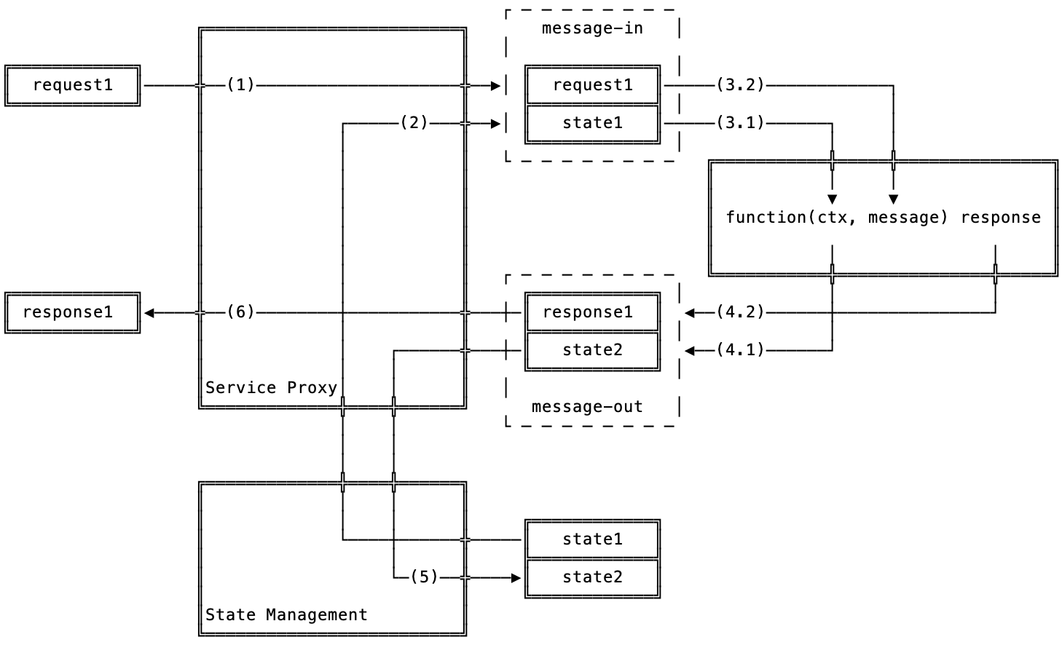
What the hell is stateful serverless?
eigr.io – Spawn Cloud Native Service Mesh
Elug SP - Meetup 2023

Slide 11
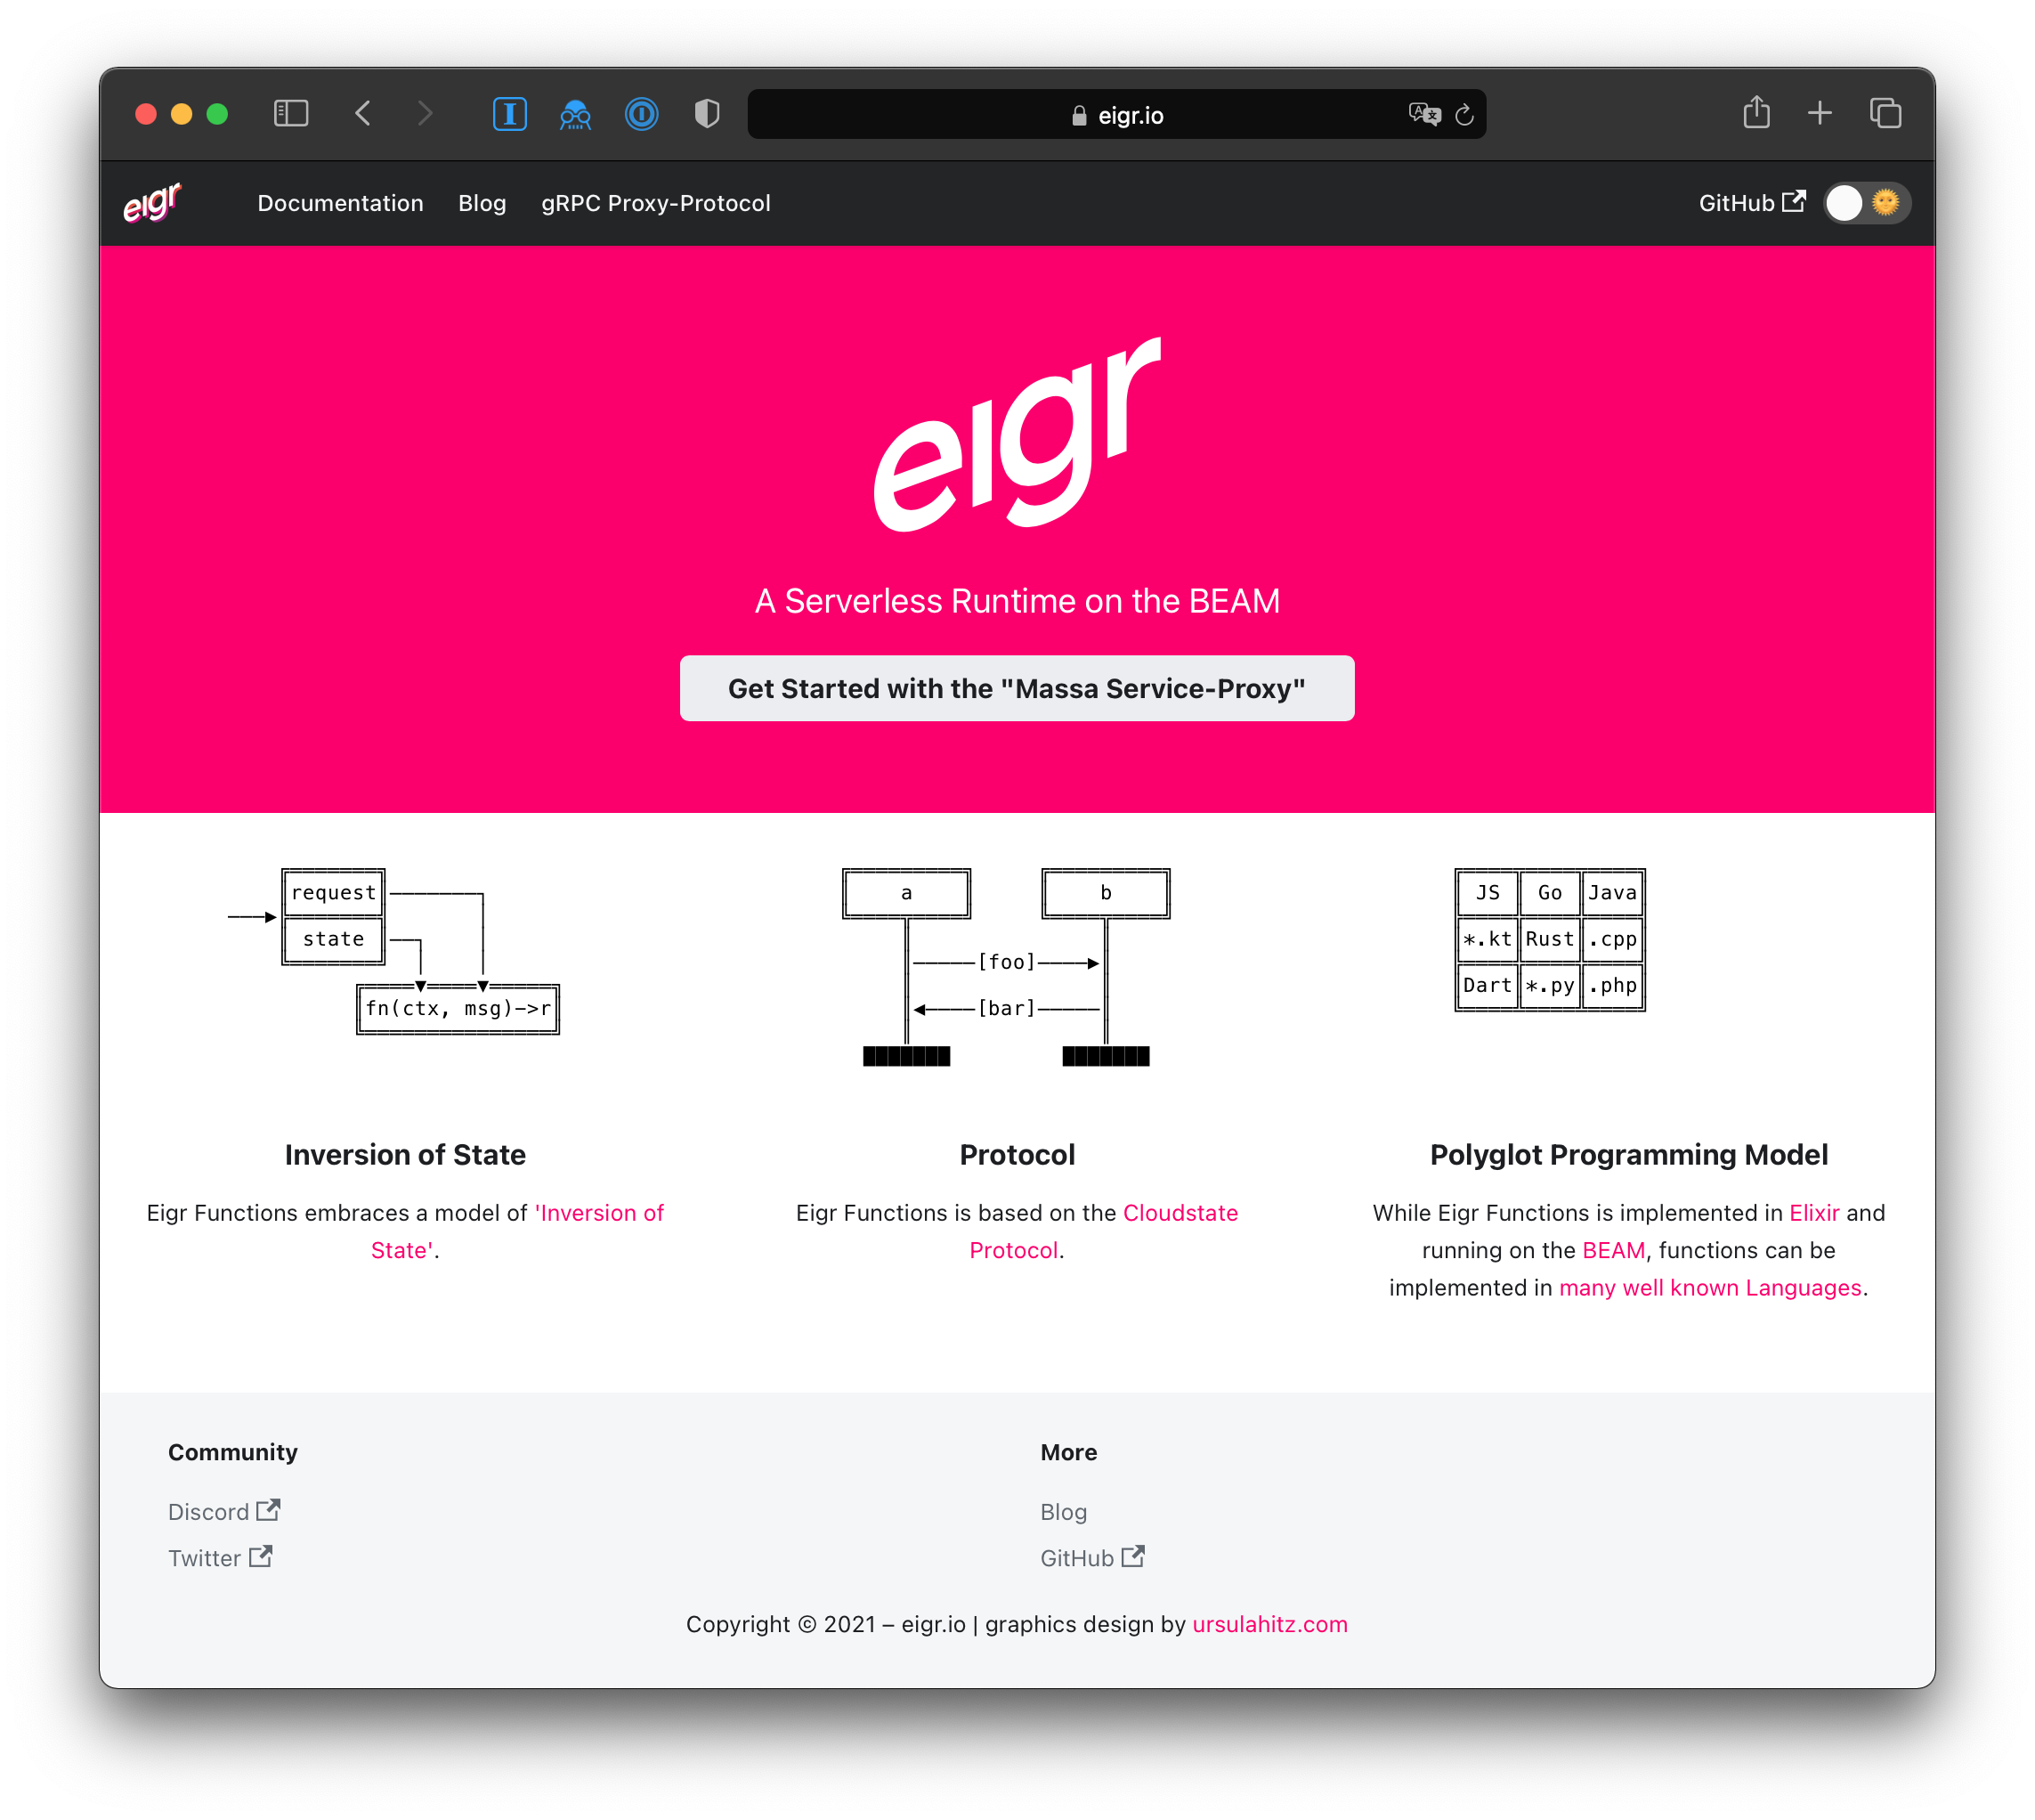
Spawn Highlights
eigr.io – Spawn Cloud Native Service Mesh
A k8s Operator & Service Proxy
State management
Workflows
Activators
Security
A Protocol
HTTP + protobuf
Declarative APIs + Polyglot Programming Model
JavaScript, Python*, Java, Go*, C#*,Elixir, …
… and it runs on the BEAM :)
https://eigr.io
Elug SP - Meetup 2023

Slide 12
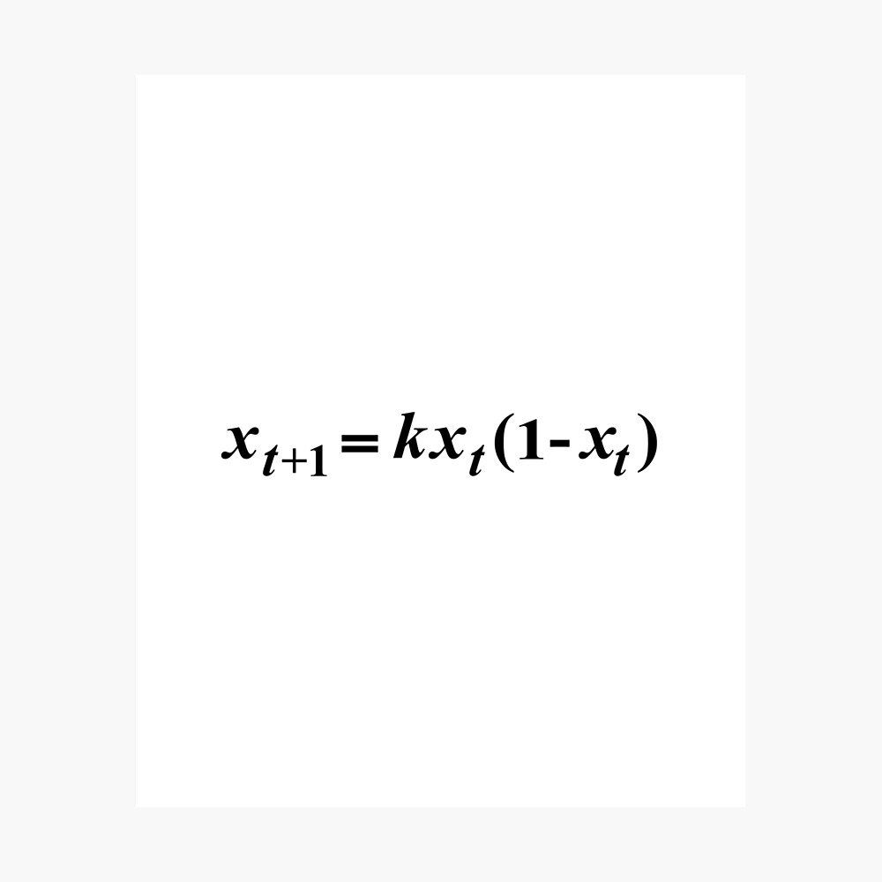
The problem of complexity
eigr.io – Spawn Cloud Native Service Mesh
Elug SP - Meetup 2023

Slide 13
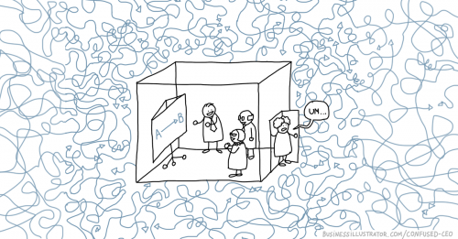
The Problem - Complexity
eigr.io – Spawn Cloud Native Service Mesh
“The Implications of a Complexity Perspective for Software Engineering Practice and Research Large software companies that enjoyed success in the past find themselves in increasing difficulties in today’s turbulent business environments. Various issues they need to tackle include delays in releasing, feature bloating, slow or no response to changing, often individual, customer needs, and so on. Meanwhile, there are a growing number of small start-ups and “second-product” companies struggling to survive and thrive in increasingly competitive market places, too. For them an accurate definition of future is impossible to achieve. They have to live in the current moment, yet strive towards their continuously evolving vision”
The Implications of a Complexity Perspective for Software Engineering Practice and Research, January 2012 - Journal of Computer Engineering and Information Technology 01(01)
Elug SP - Meetup 2023

Slide 14
The Problem - Complexity
eigr.io – Spawn Cloud Native Service Mesh
Security.
Scalability.
Performance.
Backend APIs.
Frontend APIs.
State management & Database setup.
Integration with other backends and external services.
A lot of others non functional requirements.
Elug SP - Meetup 2023

Slide 15
The Problem - Example
eigr.io – Spawn Cloud Native Service Mesh
Business Requirement (small snippet):
We need to represent our users in the system, in addition we need to be able to permanently persist their data and be able to consult this data at any time. Users must have the following attributes:
email
password
username
bio
image
Elug SP - Meetup 2023

Slide 16
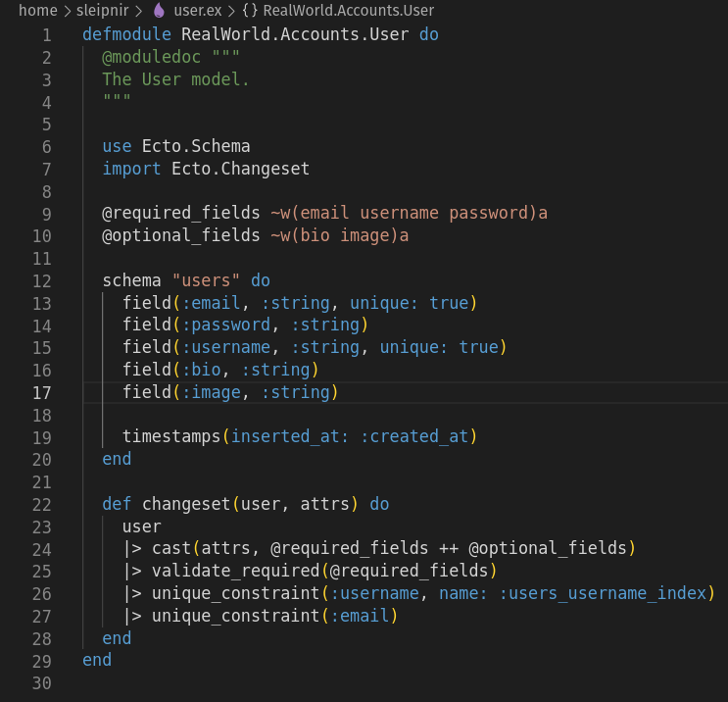
The Problem - Example 😀
eigr.io – Spawn Cloud Native Service Mesh
Elug SP - Meetup 2023

Slide 17
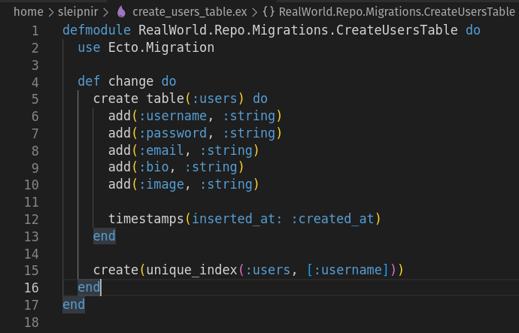
The Problem - Example 🤔
eigr.io – Spawn Cloud Native Service Mesh
Elug SP - Meetup 2023

Slide 18
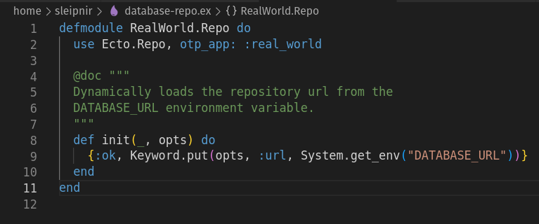
The Problem - Example 😏
eigr.io – Spawn Cloud Native Service Mesh
Elug SP - Meetup 2023

Slide 19
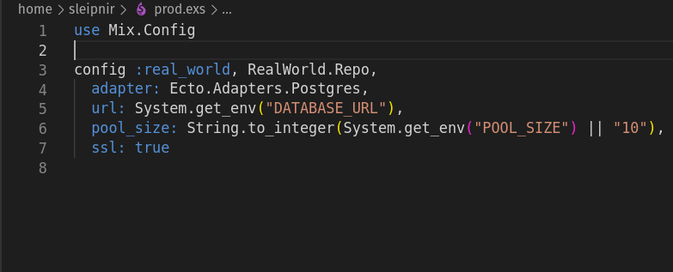
The Problem - Example 😟
eigr.io – Spawn Cloud Native Service Mesh
Elug SP - Meetup 2023

Slide 20
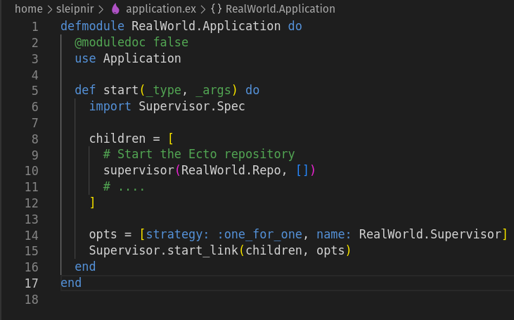
The Problem - Example 😡
eigr.io – Spawn Cloud Native Service Mesh
Elug SP - Meetup 2023

Slide 21

eigr.io – Spawn Cloud Native Service Mesh
Elug SP - Meetup 2023

Slide 22
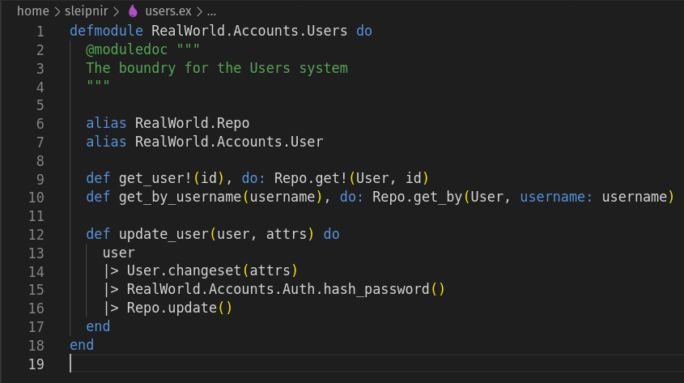
The Problem - Example 🙏
eigr.io – Spawn Cloud Native Service Mesh
Code examples from https://github.com/gothinkster/elixir-phoenix-realworld-example-app
Elug SP - Meetup 2023

Slide 23
The Problem - Notice
eigr.io – Spawn Cloud Native Service Mesh
“This is not an Ecto or Elixir problem. This is the case in any language or framework. And this is the case for every piece of infrastructure present in our code.
The question is in the form and not in the content!”
Elug SP - Meetup 2023

Slide 24
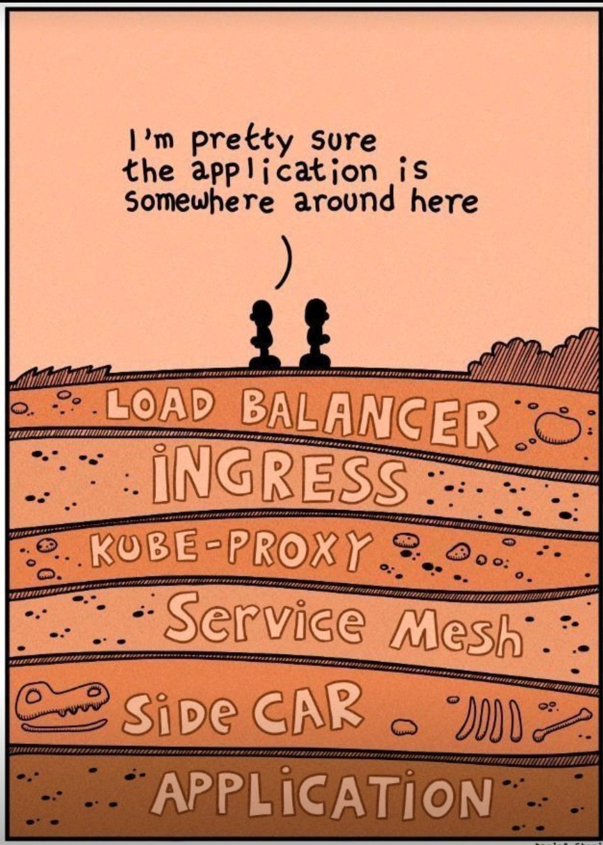
The Problem - Infrastructure
eigr.io – Spawn Cloud Native Service Mesh
Network connectivity.
High Availability
Scalability.
Sizing & Resource allocation.
Certificate management.
Zero trust & Least privilege environments.
CI/CD pipelines.
Observability & Log management.
Disk & Volume management.
LGPD, GDPR, CCPA, and other private or government regulations.
Cost.
…
Elug SP - Meetup 2023

Slide 25
eigr.io – Spawn Cloud Native Service Mesh
Elug SP - Meetup 2023

Slide 26
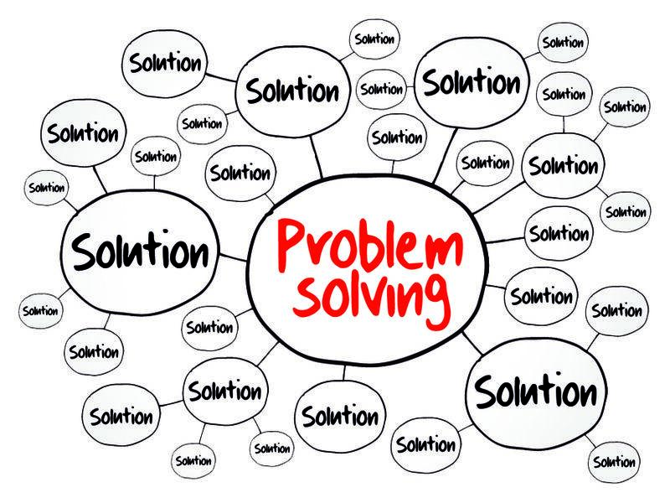
Applying the solution
eigr.io – Spawn Cloud Native Service Mesh
Elug SP - Meetup 2023

Slide 27
The Problem - Example
eigr.io – Spawn Cloud Native Service Mesh
Business Requirement (small snippet):
We need to represent our users in the system, in addition we need to be able to permanently persist their data and be able to consult this data at any time. Users must have the following attributes:
email
password
username
bio
image
Elug SP - Meetup 2023

Slide 28
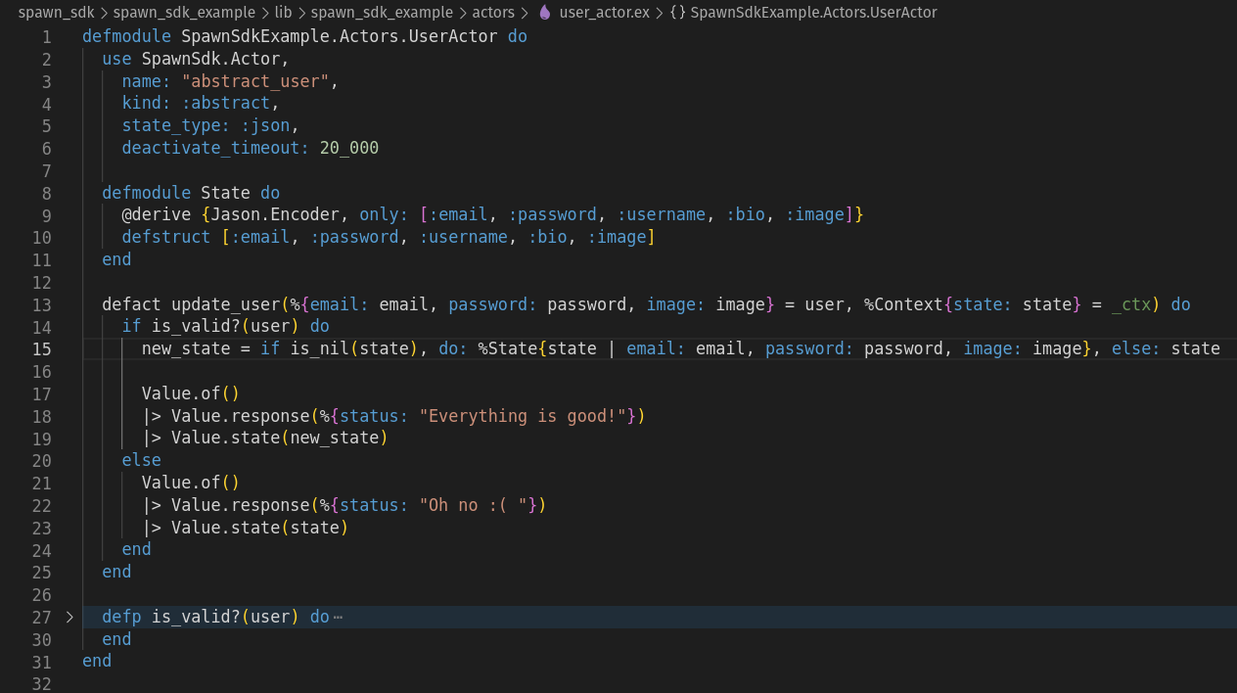
The Solution - Definition 😀
eigr.io – Spawn Cloud Native Service Mesh
Elug SP - Meetup 2023

Slide 29
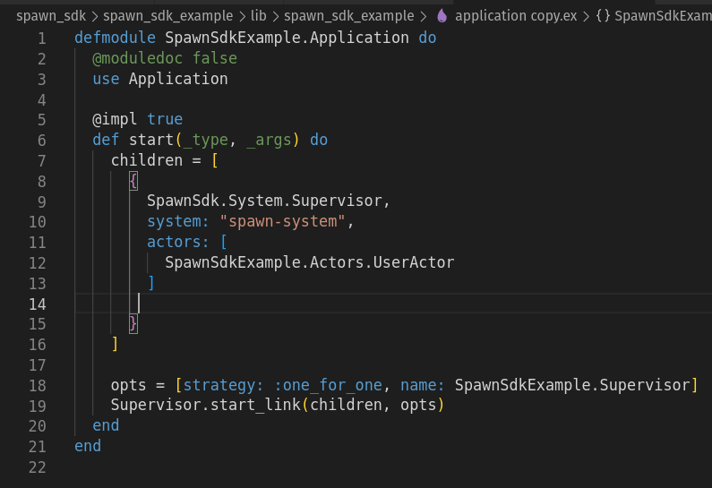
The Solution - Boilerplate 😏
eigr.io – Spawn Cloud Native Service Mesh
Elug SP - Meetup 2023

Slide 30
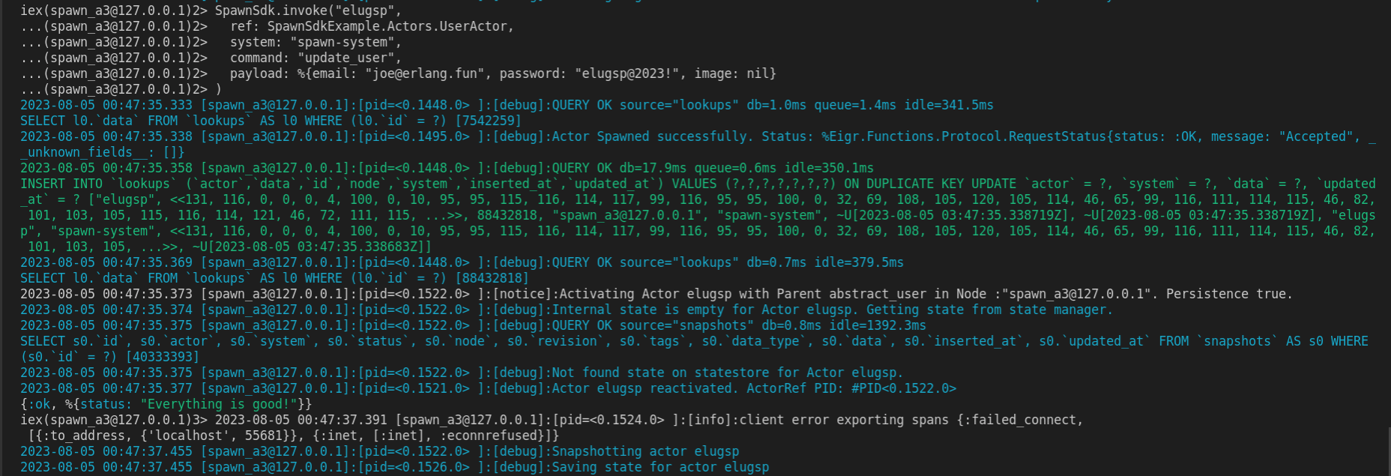
The Solution - Invoking Actors 😀
eigr.io – Spawn Cloud Native Service Mesh
Elug SP - Meetup 2023

Slide 31
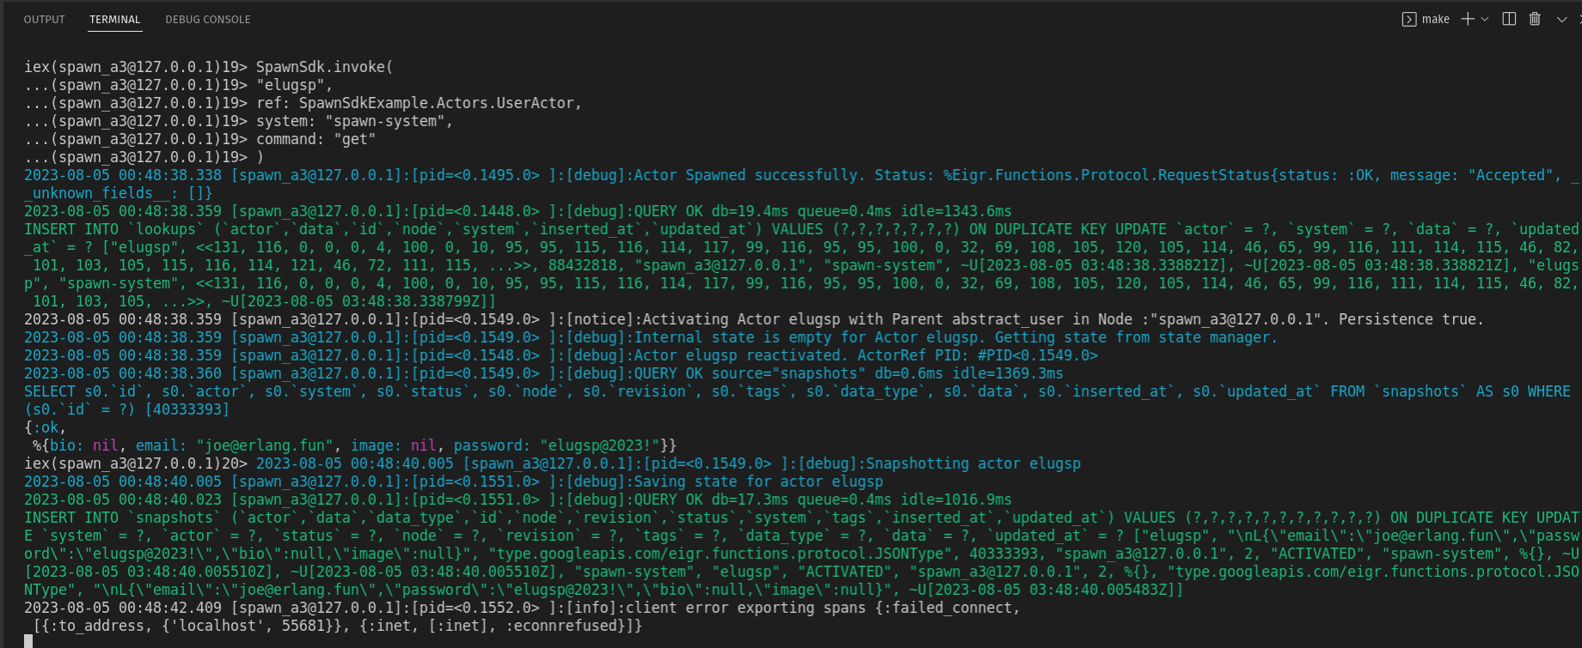
The Solution - Invoking Actors 😀
eigr.io – Spawn Cloud Native Service Mesh
Elug SP - Meetup 2023

Slide 32
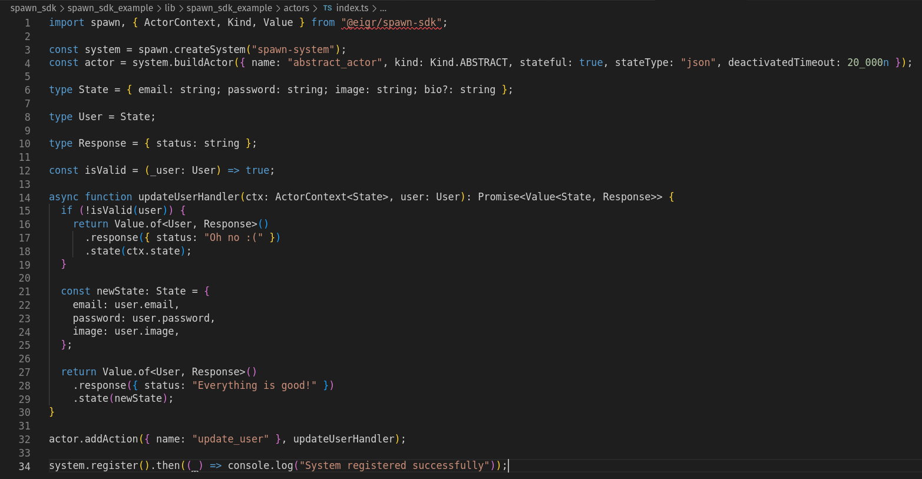
The Solution - Polyglot 😀
eigr.io – Spawn Cloud Native Service Mesh
Elug SP - Meetup 2023

Slide 33
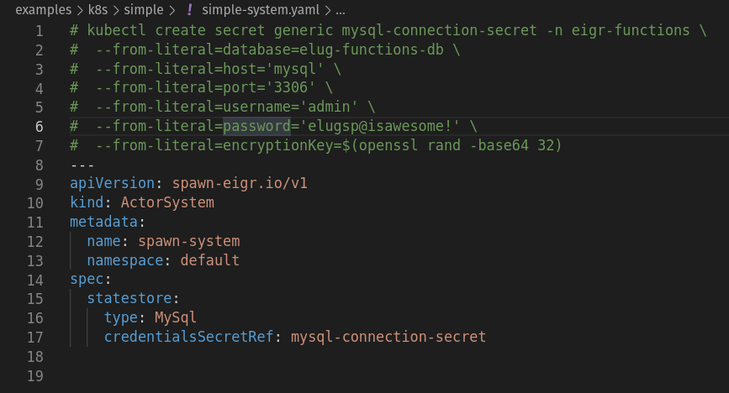
The Solution - Deployment
eigr.io – Spawn Cloud Native Service Mesh
Elug SP - Meetup 2023

Slide 34
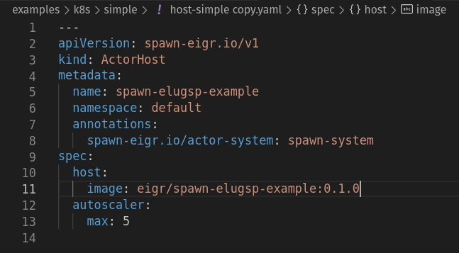
The Solution - Deployment
eigr.io – Spawn Cloud Native Service Mesh
Elug SP - Meetup 2023

Slide 35
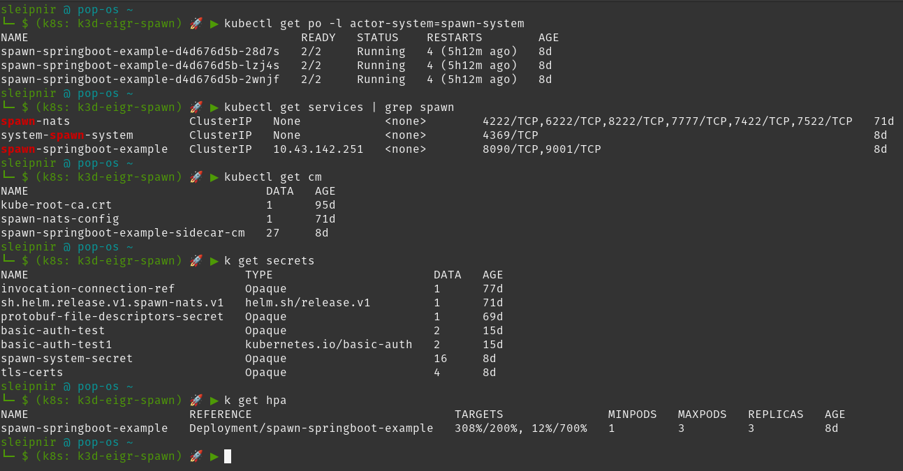
The Solution - Deployment
eigr.io – Spawn Cloud Native Service Mesh
Elug SP - Meetup 2023

Slide 36
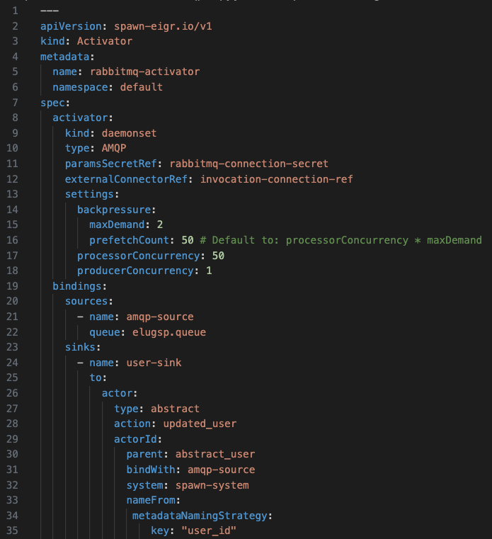
The Solution - Activators
eigr.io – Spawn Cloud Native Service Mesh
Elug SP - Meetup 2023

Slide 37
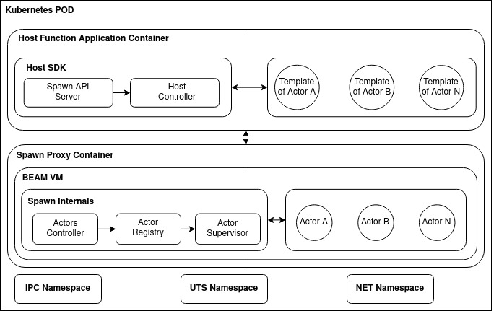
Some Concepts
eigr.io – Spawn Cloud Native Service Mesh
Every ActorHost resides in an ActorSystem that serves as an application “bucket”. This in turn is isolated from the network of other ActorSystems.
In turn, each Sidecar container within a POD organizes itself to form an Erlang cluster for each ActorSystem.
Different ActorSystems can coexist in the same Kubernetes cluster and these in turn communicate cross ActorSystem using a Nats Broker as a transport mechanism via message passing.
ACM SIGPLAN, ICFP Erlang Workshop 2021

Slide 38
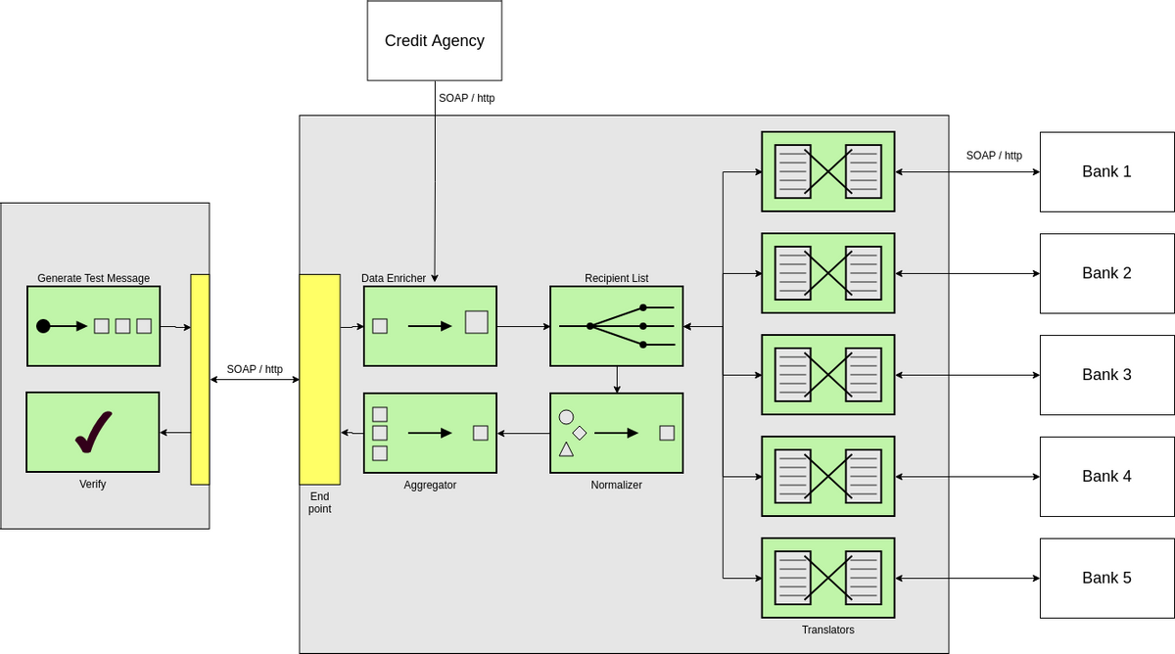
Workflows
eigr.io – Spawn Cloud Native Service Mesh
Elug SP - Meetup 2023

Slide 39
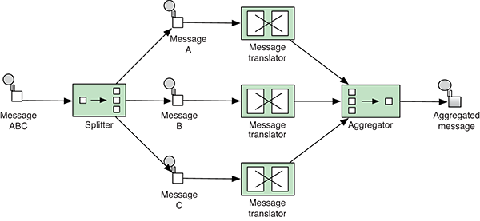
Workflows
eigr.io – Spawn Cloud Native Service Mesh
Broadcast: Communicates with other actors through pubsub channel semantics.
In Memory broadcast. Using Phoenix.PubSub as transport.
Nats broadcast. Using Nats as transport.
External Broadcast: Sends events with pubsub semantics outside the actor system using the same transport types as Broadcast.
Forwards: Forwards the input parameter of an action of an actor as input to another action of another actor.
Pipes: Forwards the output type of an action of one actor to the input of an action of another actor. Like Unix pipes.
Side effects: Sends an effect as a result of your computation for other Actors to handle.
Elug SP - Meetup 2023

Slide 40
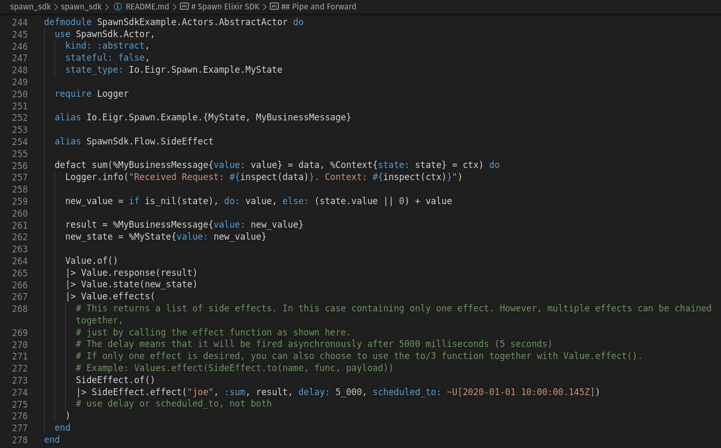
Workflows - Side Effects
eigr.io – Spawn Cloud Native Service Mesh
In cases where you want other components to be aware that a component processed a command, you can emit an effect.
Side effects are useful, among other things, to compose workload separation and aggregation flows.
Elug SP - Meetup 2023

Slide 41
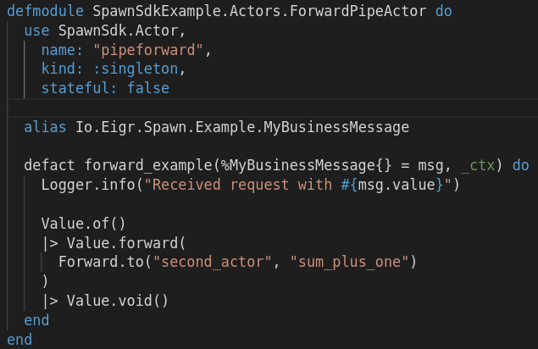
Workflows - Forwards
eigr.io – Spawn Cloud Native Service Mesh
Forward a request that was sent to one Actor to be handled by another Actor.
Very useful for creating routings between actors.
Elug SP - Meetup 2023

Slide 42
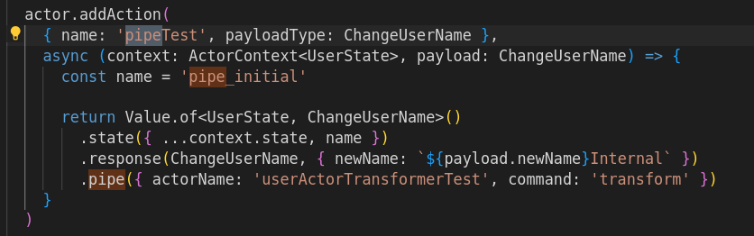
Workflows - Pipes
eigr.io – Spawn Cloud Native Service Mesh
A forward forwards a request that was sent to one actor to be handled by another actor..
Very useful for creating routings between actors.
Elug SP - Meetup 2023

Slide 43
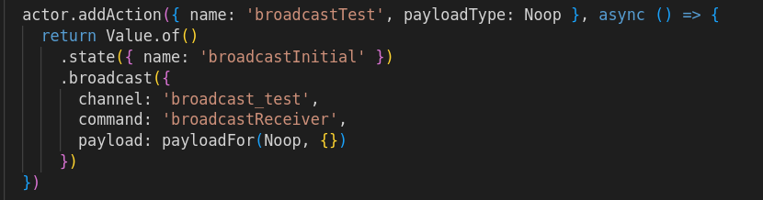
Workflows - Broadcast Sender
eigr.io – Spawn Cloud Native Service Mesh
Elug SP - Meetup 2023

Slide 44
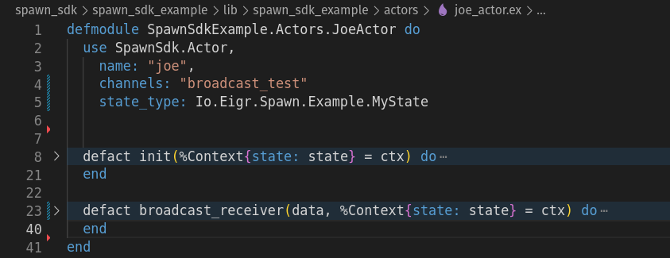
Workflows - Broadcast Receiver
eigr.io – Spawn Cloud Native Service Mesh
Elug SP - Meetup 2023

Slide 45

Let's ask uncomfortable questions to find new directions for growth!
- Brooklyn Zelenka
eigr.io – Spawn Cloud Native Service Mesh
Elug SP - Meetup 2023

Slide 46
Thanks!
eigr.io
github.com/eigr
github.com/eigr/spawn
@eigr_io
@sleipni_r
Elug SP - Meetup Adriano Santos, August 05th 2023

